Slide 1
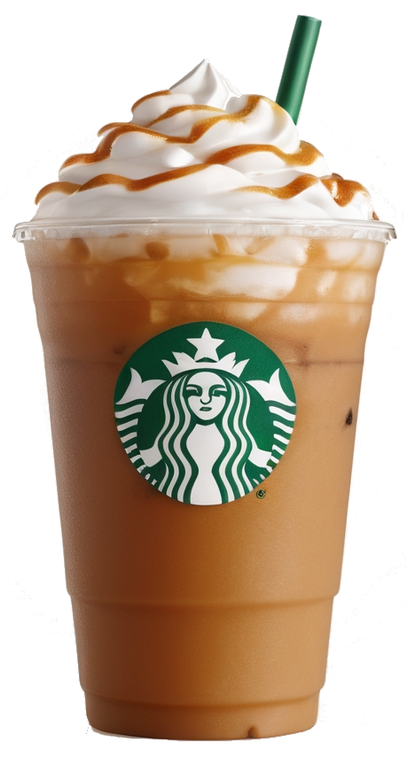
Starbucks
Elevating the Customer Experience Across the US
Team 208
Kuan Ling Chen, Daniel Farr, Koushika Ravikumar, Shristi Gaur

Slide 2
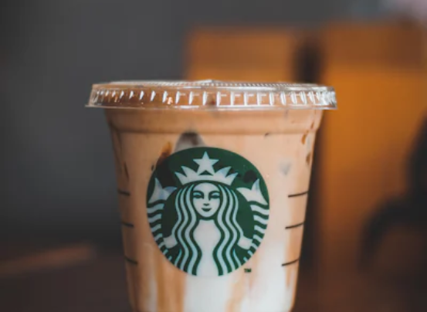
Agenda
Introduction
Analytics
Recommendations
Conclusion

Slide 3
Why Starbucks?

Slide 4
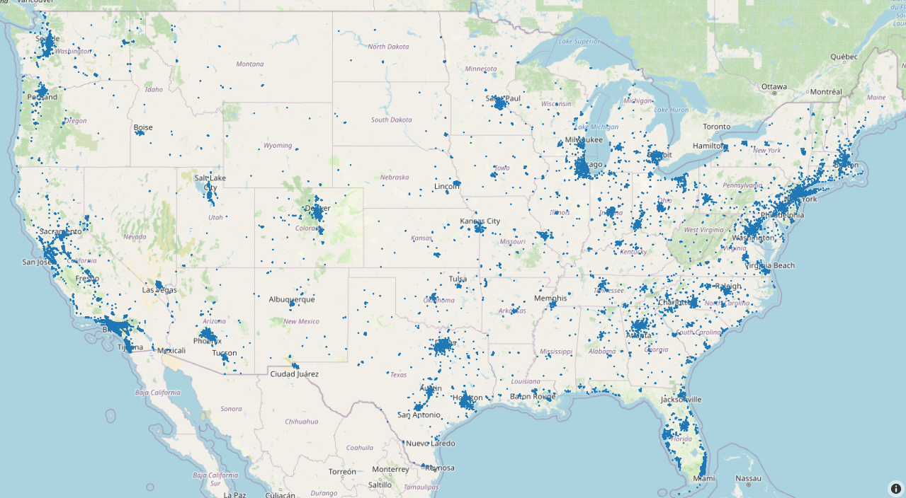
Introduction- Starbucks Store distribution
15,882
2024 Starbucks Store Distribution and Count in the US

Slide 5
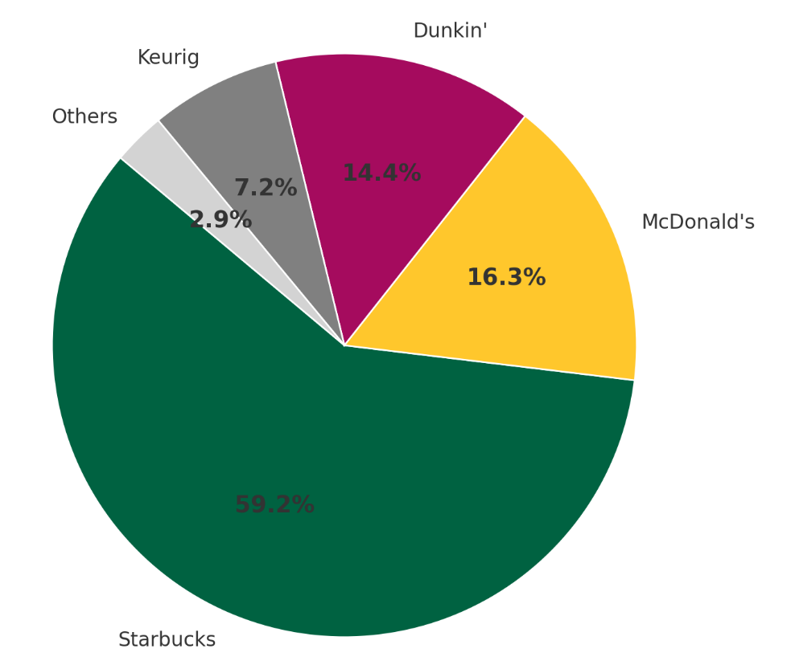
Introduction- Key Reasons for Analyzing Starbucks
Coffee chain market share percentage
Global Market Leader -
Global Market Size: ~$495 billion (2023)
Brand Loyalty
Competitive & Strategic Insights
Notes:
Brand Loyalty – built a strong customer base through personalized experiences, an extensive rewards program, and a high level of customer engagement.
Competitive & Strategic Insights give Starbucks an edge over its rivals – expanding globally, and optimizing its supply chain efficiency

Slide 6
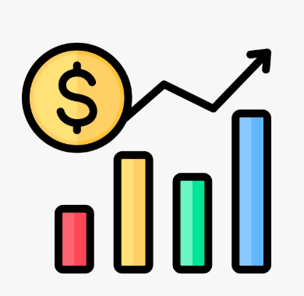
Introduction-Why Analyzing Reviews Matters
Harvard Business School:
A one-star increase in Yelp rating leads to a 5-9% increase in revenue
Data Source:https://www.hbs.edu/ris/Publication%20Files/12-016_a7e4a5a2-03f9-490d-b093-8f951238dba2.pdf
Notes:
and also why are we analyzing reviews, according to the research by the harvard business school when thet are research for the yelp dataset. its shows that when there is a one star increase in yelp rating, there would lead about 5-9 % in revenue, so reviews matter.

Slide 7
Introduction-How We Analyze Starbucks' Customer Insights
Objective:
Help Starbucks better understand their customers across the United States.
Method:
Utilize review scores and sentiment analysis to measure customer experience
Expected Outcomes:
Identify key factors that influence customer satisfaction on starbucks
Find regional differences in customer satisfaction
Notes:
Help Starbucks better understand their customers across the United States

Slide 8
Data preprocessing & Cleaning
Raw Data
Collect business and review data
Inner join business and review data
Remove noise (spam, duplicates, and missing values)
Filter only coffee and cafe businesses
60,000 Reviews
20,000 Reviews
Extract Starbucks data
Notes:
To prepare our data, we did an inner join of the business and review json files that included all records that had coffee or cafe in their category. This put the total number of records at about 600,000. To make our analysis more feasible given the time and resources we have, we pivoted to focusing on analyzing Starbucks reviews rather than reviews for all coffee shops. Focusing on just Starbucks puts the total record count at around 20,000.

Slide 9
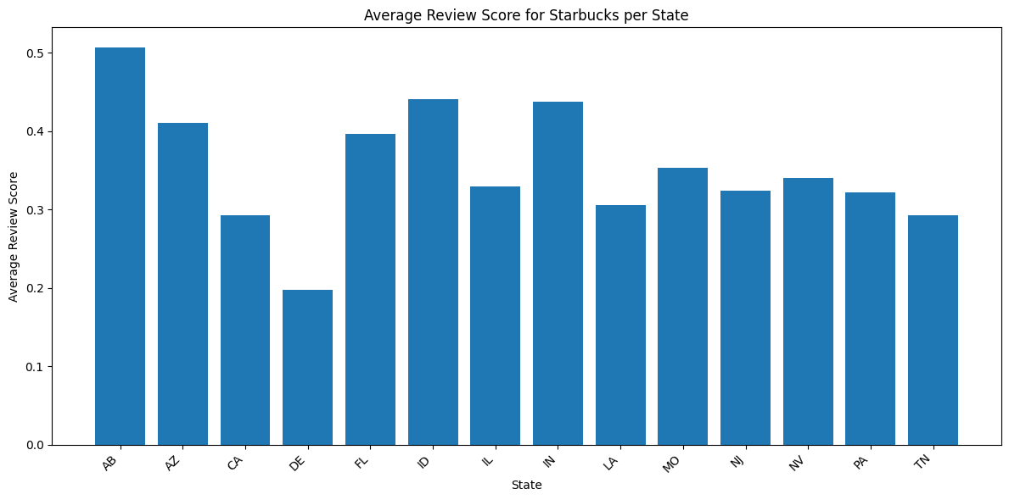
Sentiment Analysis - Average Score per State

Slide 10
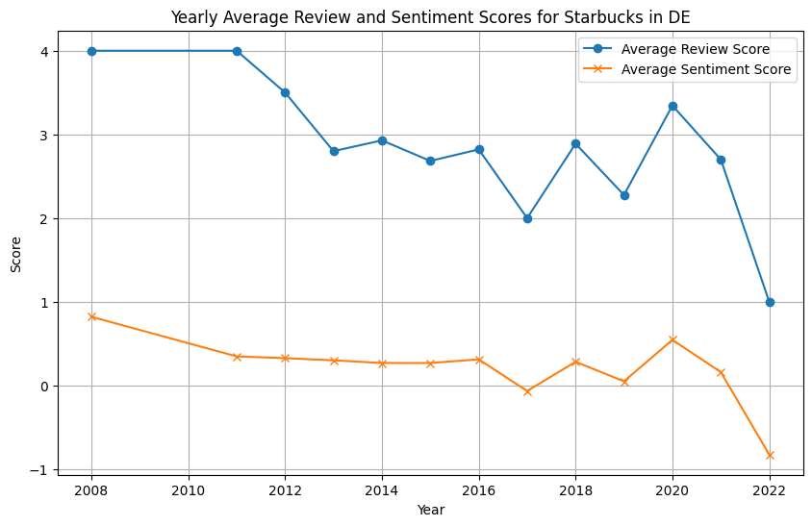
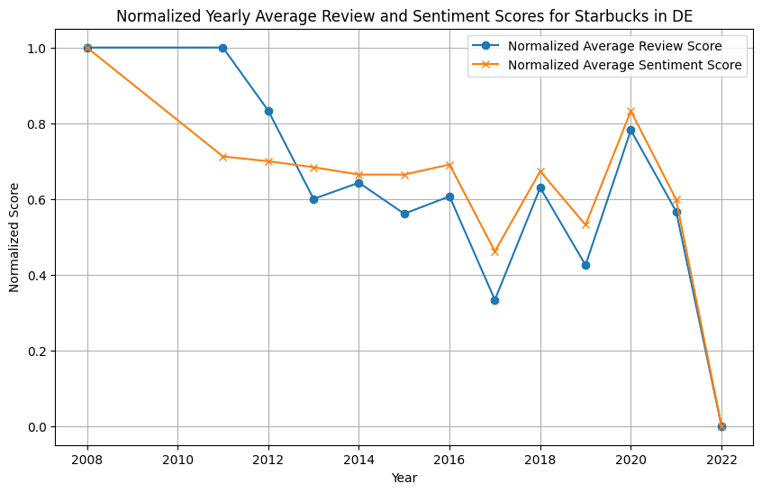
Sentiment Analysis
Delaware

Slide 11
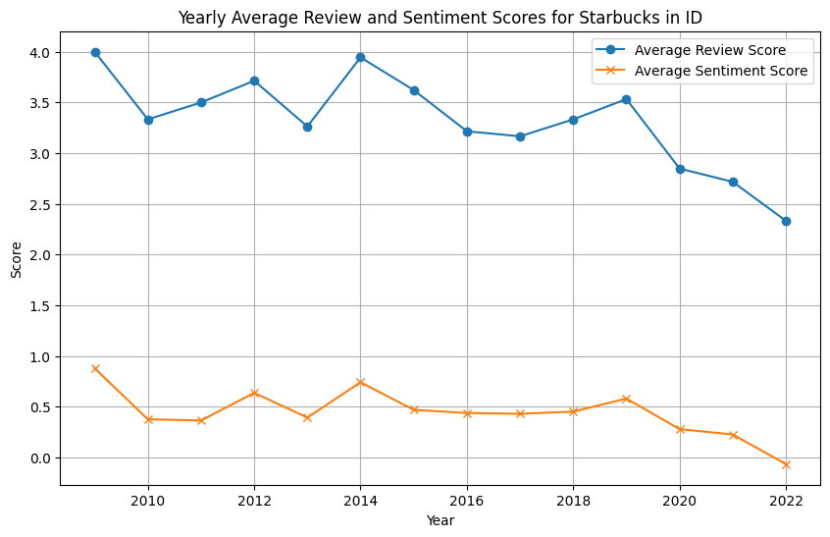
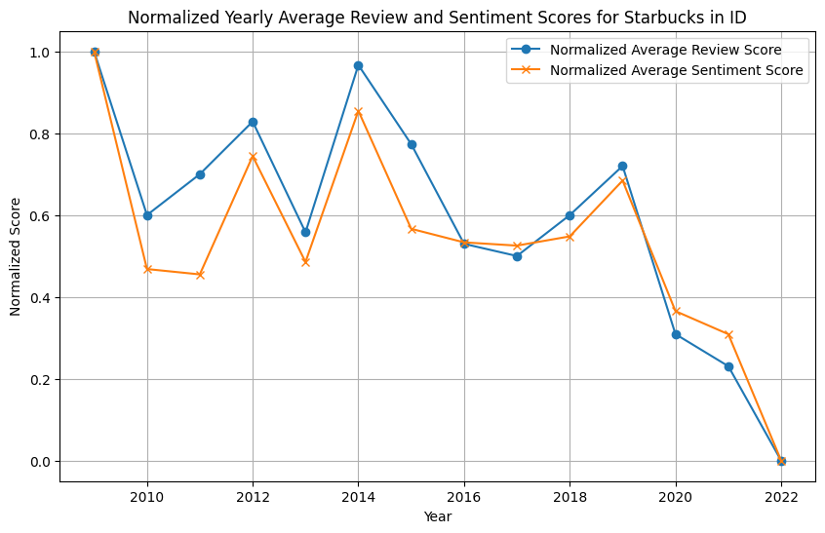
Sentiment Analysis
Idaho

Slide 12
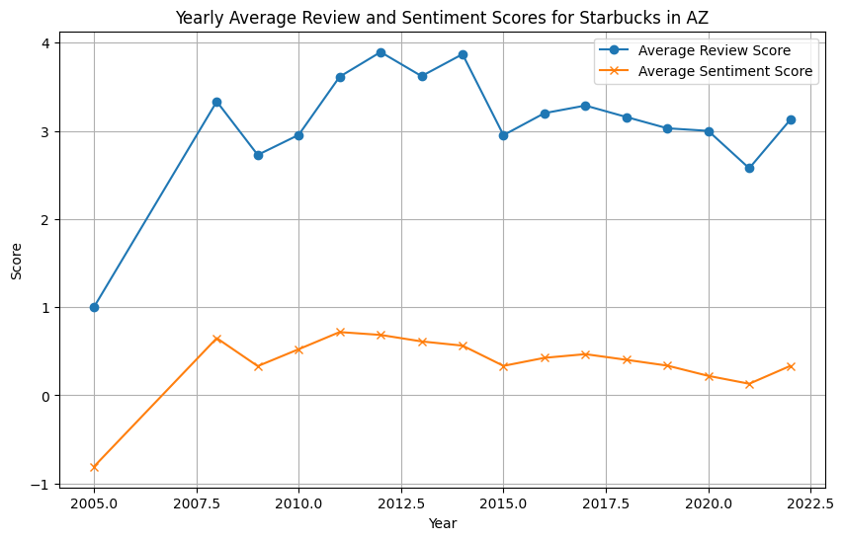
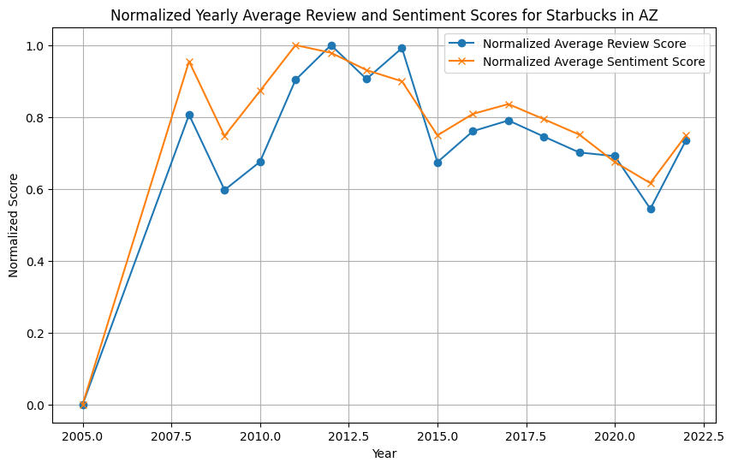
Sentiment Analysis
Arizona

Slide 13
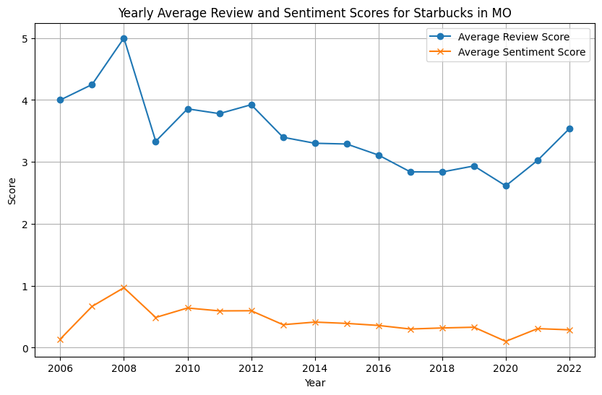
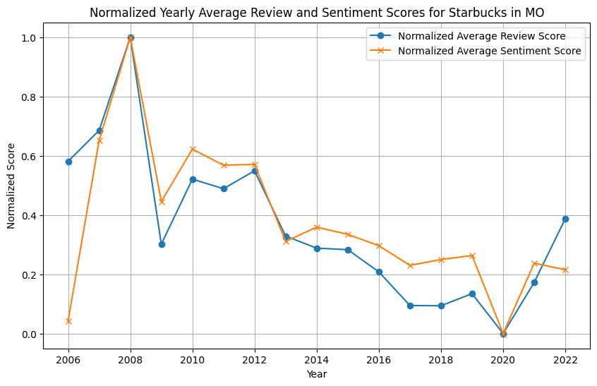
Sentiment Analysis
Missouri

Slide 14
Sentiment Analysis
We found that average customer sentiment and average review scores are indeed correlated (i.e. when review scores dip, customer sentiment dips a similar amount).
Some observations:
In many states, customer sentiment has trended downward between 2008 and 2022 (with Delaware and Idaho being especially bad)
Some states are performing relatively well with less of a decline in sentiment and even major improvement in recent years (e.g. Arizona and Louisiana)

Slide 15
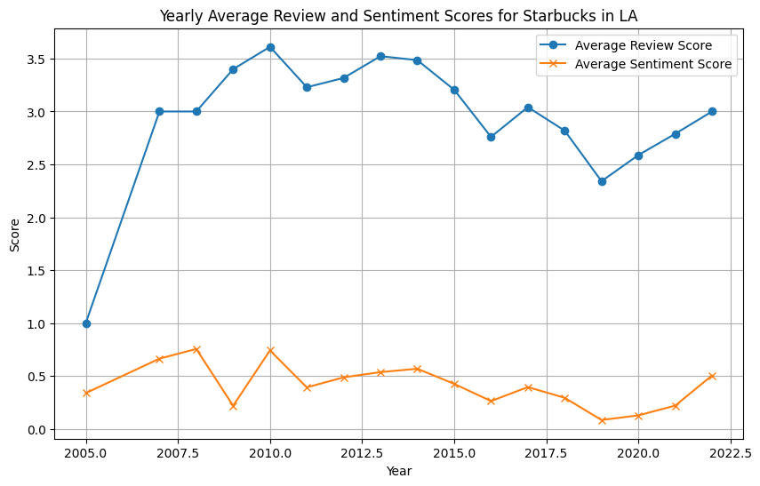
Sentiment Analysis - AZ AND LA
From our preliminary data exploration, we found that the average review scores and customer sentiment has been declining at Starbucks in most states, with the exception of Arizona (AZ) and Louisiana (LA) where we see notably higher averages.

Slide 16
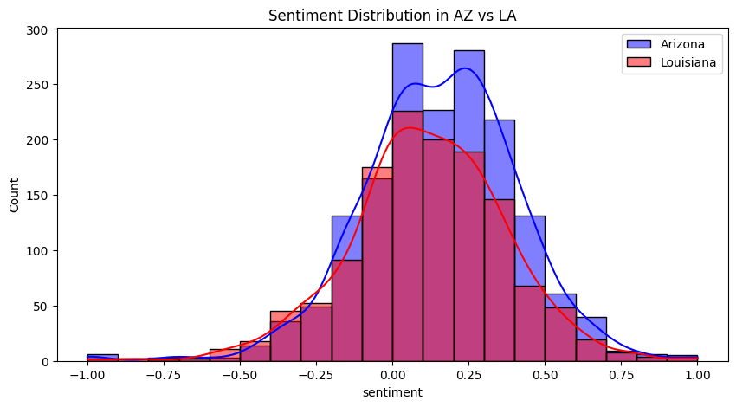
Sentiment Analysis - AZ vs LA
Arizona’s sentiment is mostly neutral to slightly positive
- The blue bars are taller around 0, meaning most sentiments in Arizona are neutral or slightly positive.
2. Louisiana’s sentiment is more spread out
- The red bars are more evenly spread, showing a wider range of positive and negative sentiments.
3. Arizona’s sentiment curve has a sharper peak
- The blue line (Arizona) has a higher peak, meaning most opinions are similar and less varied.
4. Louisiana’s sentiment is more diverse
- The red line (Louisiana) is flatter, meaning there are more mixed emotions, with both positive and negative sentiments.
5. Arizona leans slightly positive
The blue curve is skewed slightly to the right, indicating more positive sentiments than negative ones.

Slide 17
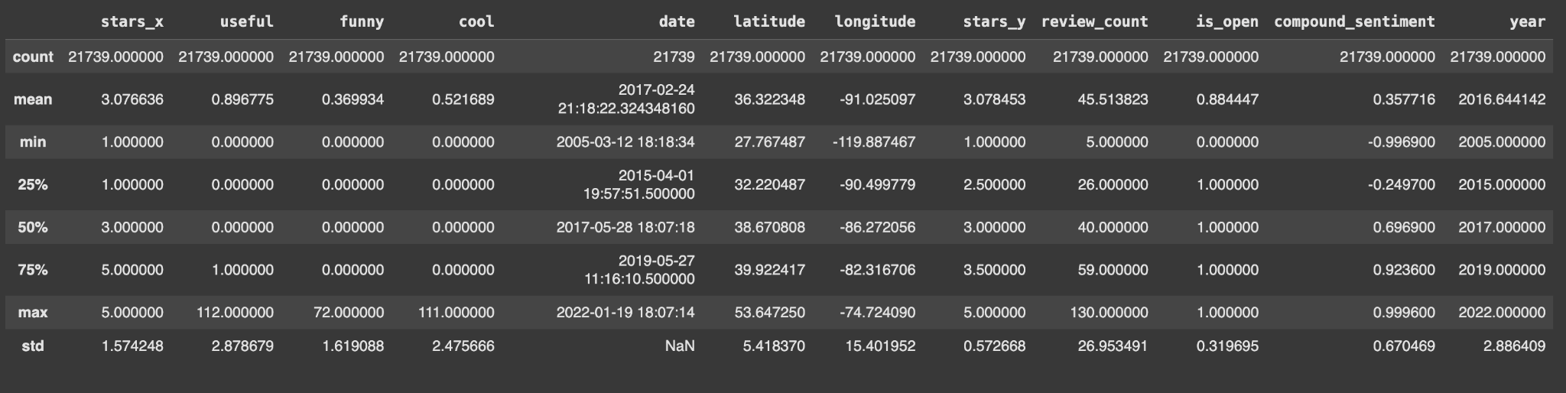
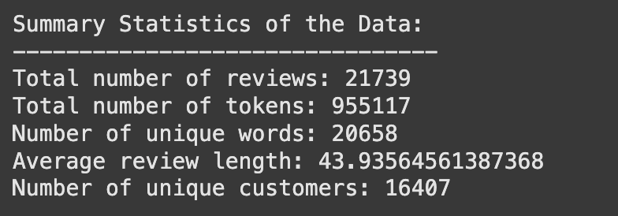
Descriptive Analysis of the Starbucks Dataset
21,739 reviews covering ratings, sentiment, engagement, and business status.
Mean (Average):
Stars_x: Average rating is 3.08, indicating a balanced distribution of ratings.
Minimum (Min):
Stars_x: Lowest rating is 1, possibly indicating poor reviews.
Standard Deviation (Std Dev):
Stars_x: High variability (1.57) in ratings, indicating diverse opinions.

Slide 18
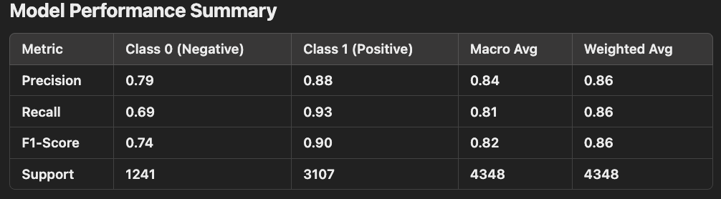
Classification Metrics
High accuracy (85.92%) → Strong overall performance.
Class 1 (Positive) performs well → High precision and recall.
Class 0 (Negative) recall is lower → Some negative cases may be misclassified.

Slide 19
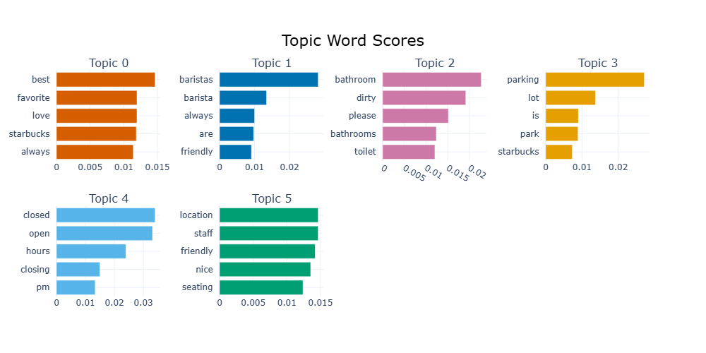
Topic Modeling
We used BERTopic to identify some common strengths and weaknesses among Starbucks cafes. This should provide insight and direction on addressing the problems that are leading to the decline in customer sentiment.

Slide 20
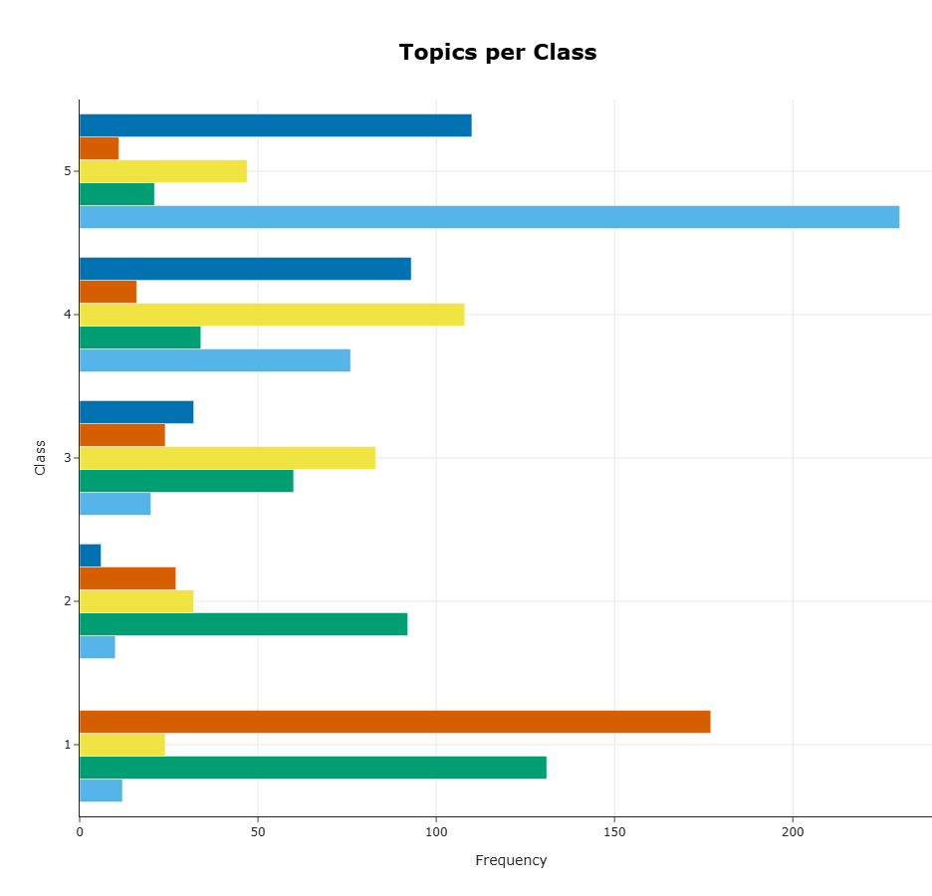
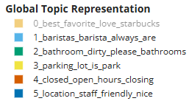
Topic Modeling
Most frequent topics in:
5 star reviews:
Friendly baristas
3 & 4 star reviews:
Bad parking
1 star reviews:
Dirty bathrooms, dirty cafe
Cafe closed

Slide 21
Topic Modeling
Review snippets that are representative of the most notable topics:
Topic 3: “Place is dirty. Tables and chairs and floors dirty, makes you wonder about food and drinks. Bathroom was filthy also. Pretty gross.Will definitely visit a different location (of the hundreds around).”
Topic 4: “That parking lot is a NIGHTMARE! I would never park in there because the drive thru line is so long that you would never be able to back out of the parking spots. Sometimes the line will be so long coming from two different entries into the parking lot that street traffic will be backed up. I usually park across the street and walk there so I don't get trapped.”
Based on the insights from these topics, improving the on-premises cleanliness and alleviating parking congestion are crucial to improving sentiment.

Slide 22
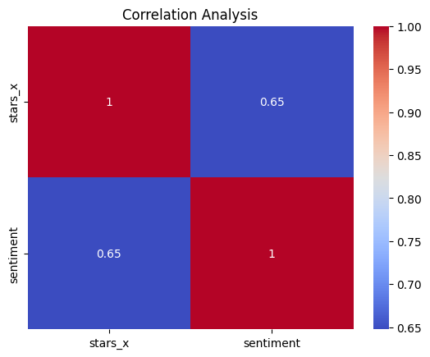
Correlation Analysis
Correlation Analysis heatmap shows the relationship between star ratings (`stars_x`) and sentiment scores (`sentiment`).
1. Correlation of 0.65
A score of 0.65 means that higher sentiment usually leads to higher star ratings.
People tend to give better ratings when they express more positive emotions.
2. Not a Perfect Correlation
Sentiment doesn’t fully determine ratings.
Some reviews may have positive words but still get low star ratings because of other factors (like price, service, or expectations).
3. Business Recommendations:
Improve customer experience → Increase positive sentiment → Higher star ratings.
Monitor sentiment trends to identify potential dissatisfaction before it impacts overall ratings.
Consider other influencing factors beyond sentiment, such as product quality, service, and pricing.

Slide 23
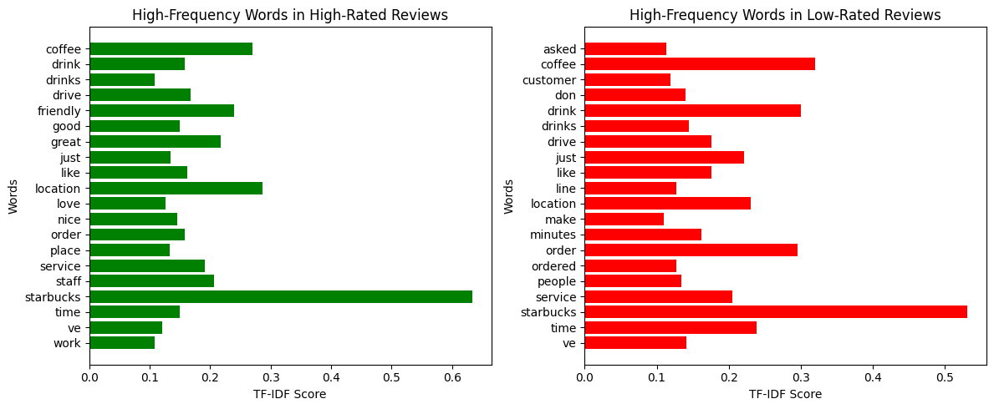
Geographic & Keyword Analysis → TF-IDF vectorization
Common Focus: Starbucks, coffee, drink, service, location appear in both high and low-rated reviews.
Positive Reviews: Highlight friendly, great, love, nice - praising service and experience.
Negative Reviews: Mention *asked, line, minutes, ordered -indicating frustration with wait times and order issues.
Conclusion: Customers appreciate good service, while delays, long wait times, service issues and order mistakes drive negative feedback.
Optimizing speed, efficiency, and customer interactions can improve overall ratings.

Slide 24
Recommendations & Managerial Insights
Identify the policies and procedures in place in high-performing markets regarding cleaning and parking (AZ, MO, LA) to the poor performing markets then begin implementing the policies that the successful markets are using in the struggling markets
To accomplish this, we recommend meeting with managers from the high-performing markets to gather the necessary information then put together a support team that can work with managers in struggling markets using this information to ensure that the new policies are being implemented effectively
Continue to gather Yelp review data, review scores, and review text to monitor shifts in sentiment and gauge success of policy changes

Slide 25
Conclusion
We believe that this data, our analysis, and recommendations based on our analysis can help Starbucks strengthen its relationship with its customers.
In turn, this will help maintain strong customer loyalty and ultimately help sustain strong profitability.

Slide 26
Thank You!

